Slide 1

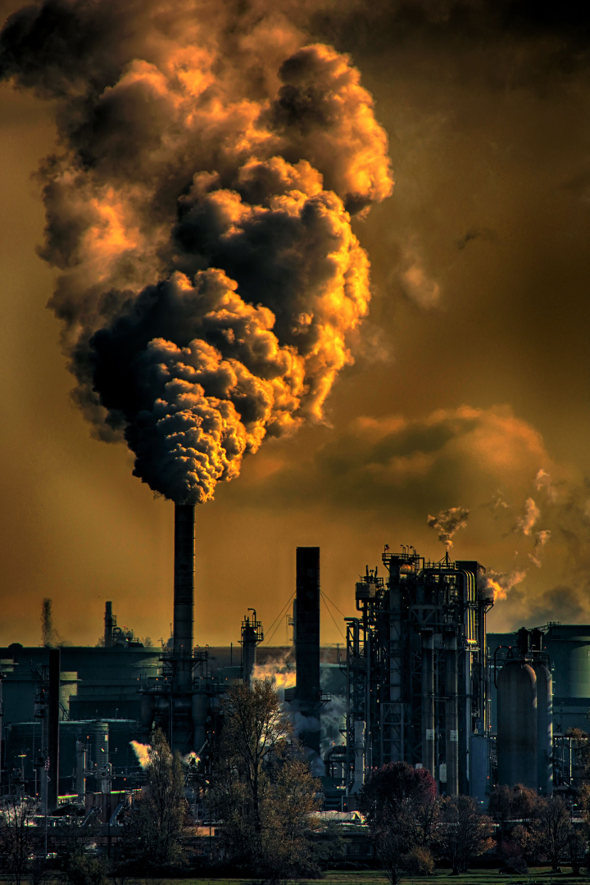
Respiratory Ailments: Air Pollution & other risk factors
A presentation by Group 1, MTH208
Instructor: Prof. Dootika Vats
Date: 9th November, 2023

Slide 2

Motivation
1
Major Concern
2
Exploring the Relationship
In India, respiratory illnesses have become a major concern. 10.38% of total deaths in India were due to lung disease as per WHO data published in 2020.
This presentation aims to explore the relationship between respiratory illnesses and risk factors such as air pollution in various states and cities
3
Data Analysis
4
Intersting Questions
By analyzing various datasets and conducting statistical analysis, we can gain valuable insights into the factors that contribute to respiratory illnesses.
Exploring any interesting questions, we encounter along the way :)

Slide 3
Data Sources
In order to investigate the relationship between respiratory illnesses, air pollution, and household factors, we utilized several datasets:
Prevalence of ARI
Household Variables
Air Pollution Data
Literacy rates
NO2, SO2, PM2.5, and PM10 levels for different cities in India in the year 2011
In children under the age of 5
Use of clean cooking fuel
Tobacco usage in men and women
Total Deaths and Cases
Due to respiratory illnesses statewise

Slide 4
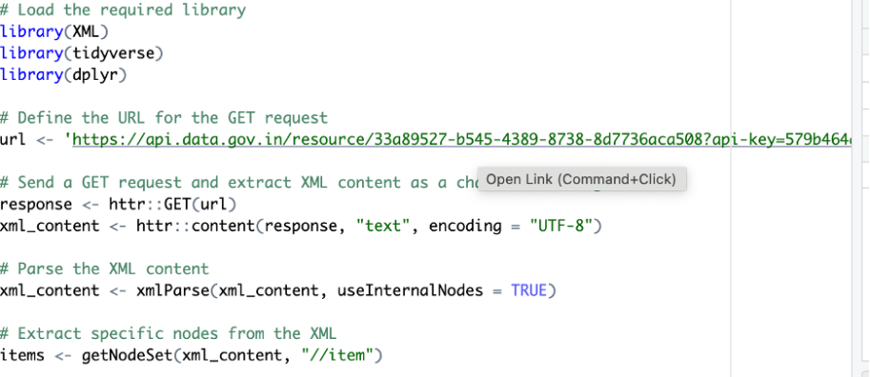
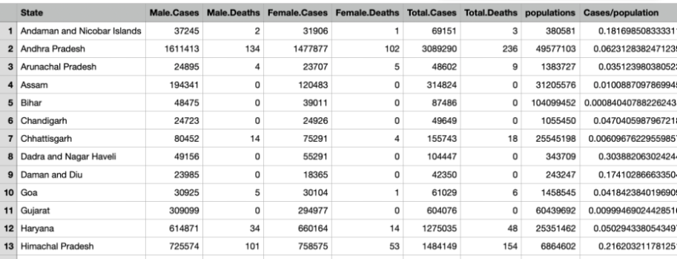
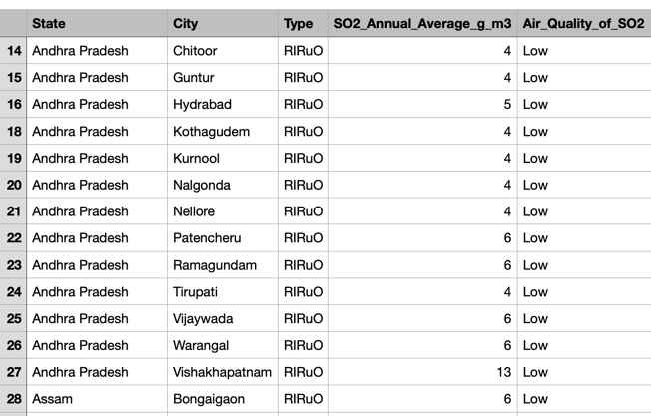
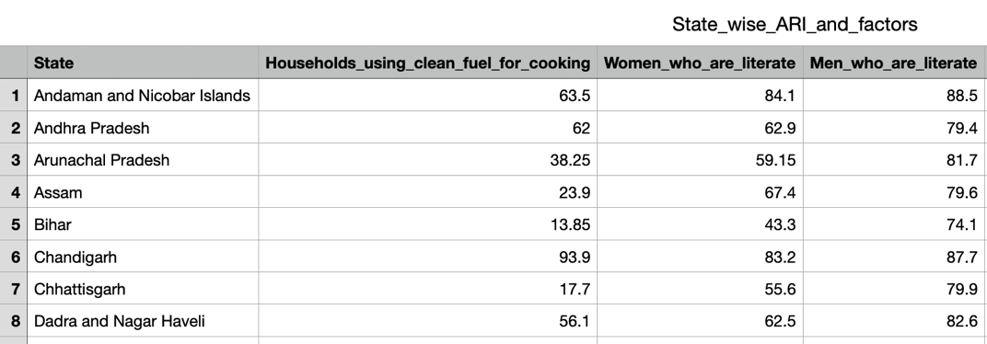
1
Data Scraping
data.gov.in
Data Processing
2
API
XML to tibble
csv, excel
Cleaning dataset:
Statewise analysis

Slide 5

Interesting Questions
As we explore the relationship between respiratory illness and various risk factors, our analysis aims to answer questions such as:
How does air pollution (NO2, SO2, PM2.5, PM10) correlate with ARI prevalence in children?
Which states do the best and worst in mitigating ARIs ?
Which states are the most polluted?
How do household variables like clean cooking fuel usage and tobacco use impact respiratory health?

Slide 6
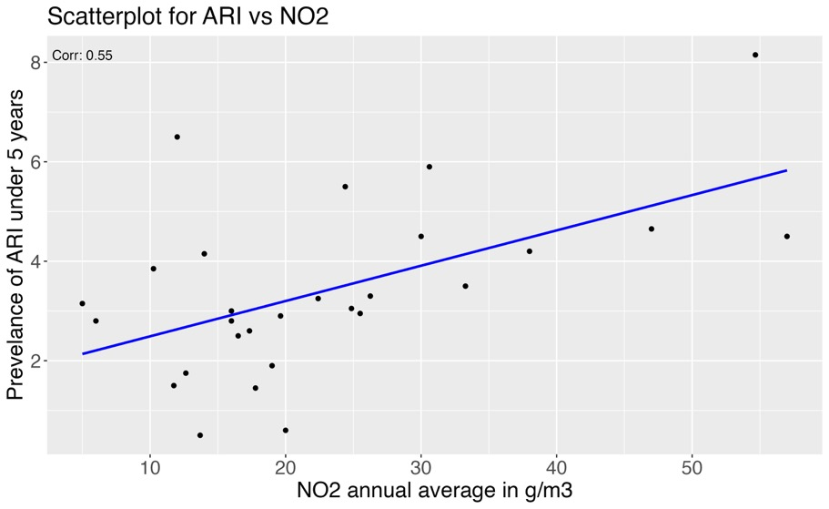
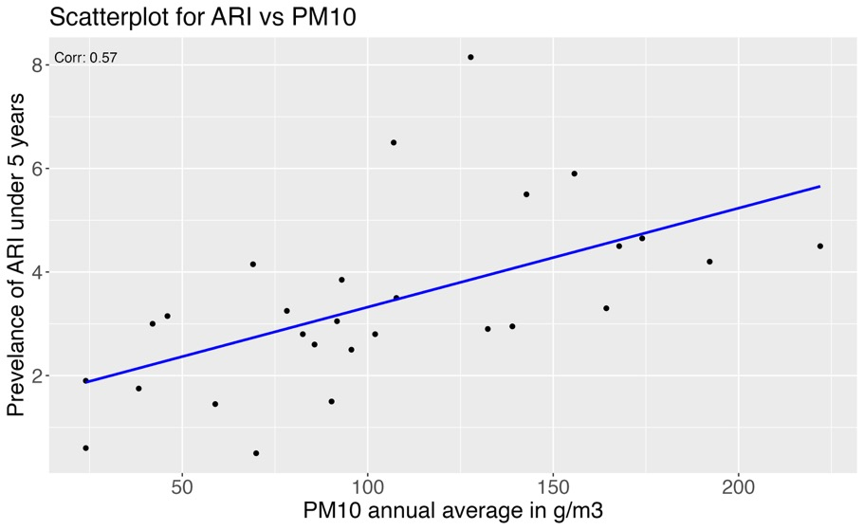
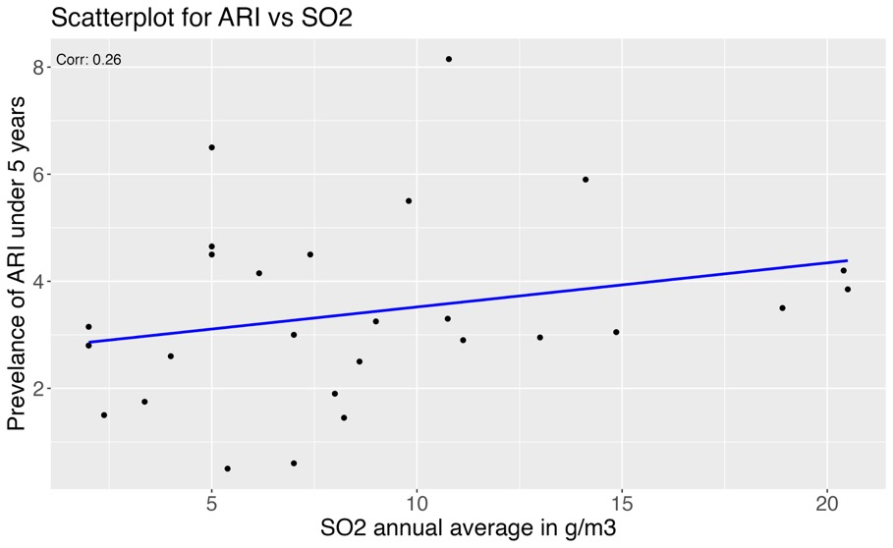
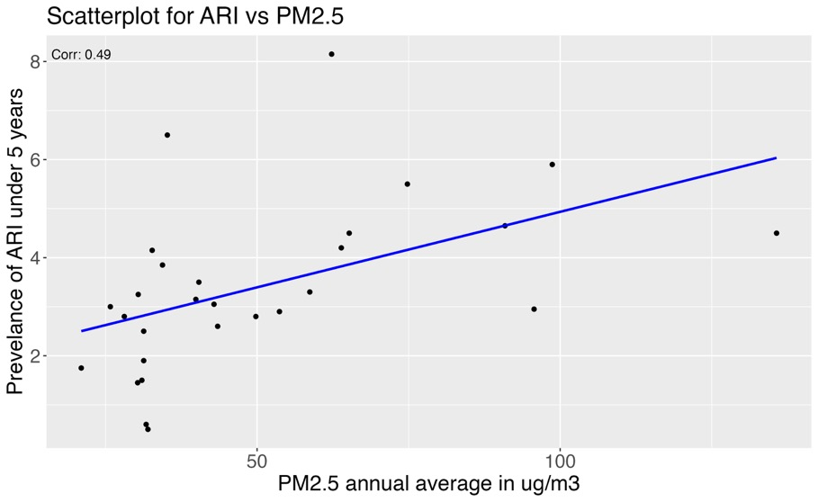
Data Exploration
Which pollutants are most hazardous?

Slide 7
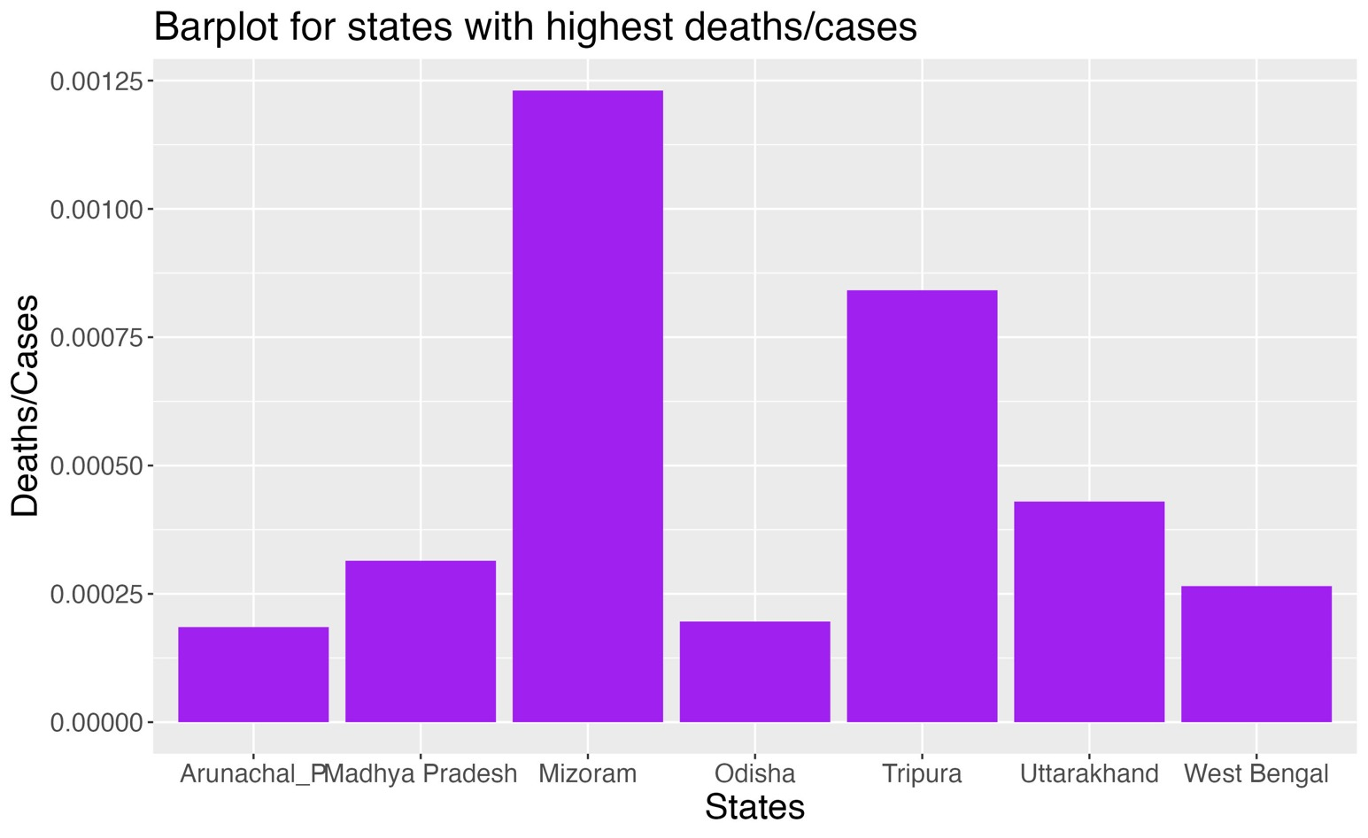
https://drive.google.com/file/d/1OsgywLJ_LSmgTjiAnKupZQzLFgqARlax/view?usp=drive_link
Which states are best/worst at mitigating ARIs?
States like Assam , Bihar and Chandigarh do bestarh do best

Slide 8
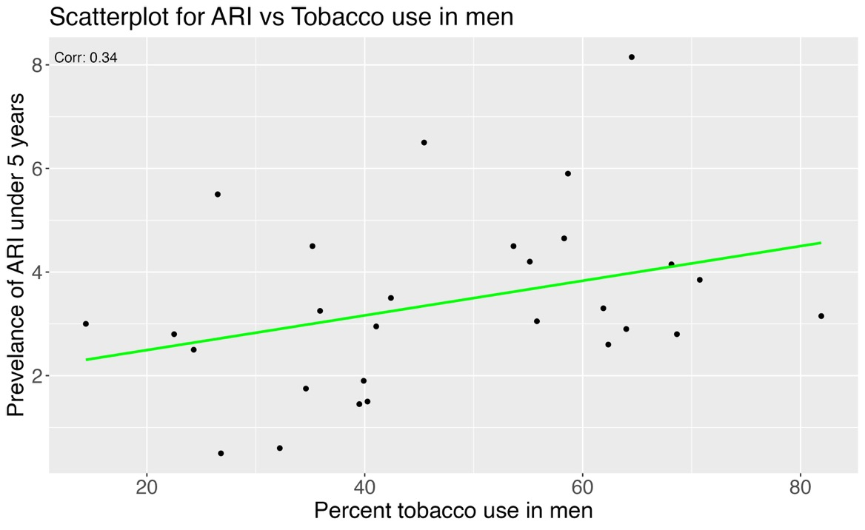
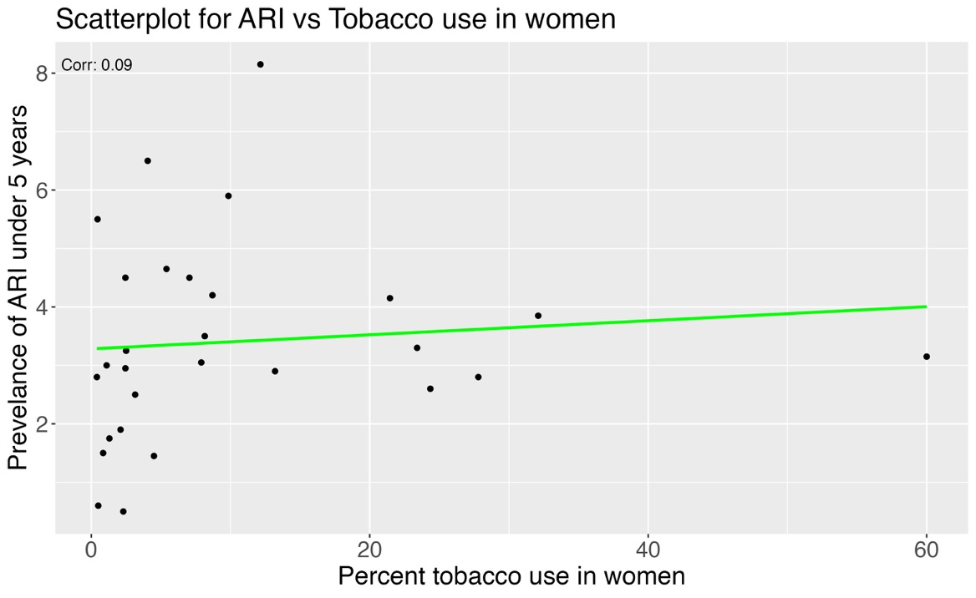
Effect of Tobacco usage in men vs women & Household factors

Slide 9
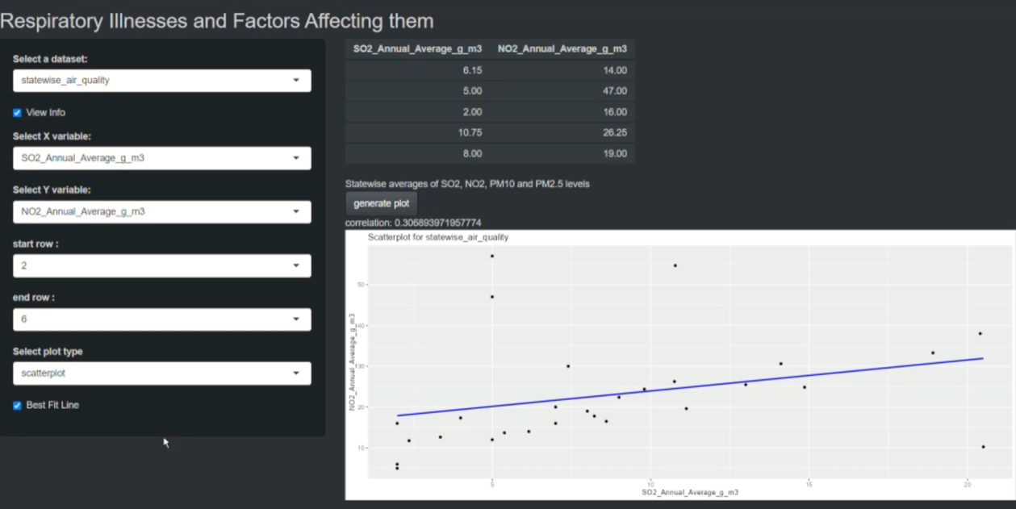
Shiny App
To provide an interactive experience, we developed a Shiny App that allows users to explore the correlations found in our analysis.
Through the app, users can delve deeper into the relationships between air pollution, household factors, and respiratory illnesses.
The interface is flexible to allow for gaining insights through the variables that were not considered in analysis in this presentation
Video demonstration: https://drive.. /file/d/1OsgywLJ_LSmgTjiAnKupZQzLFgqARlax/viewgooglecom

Slide 10
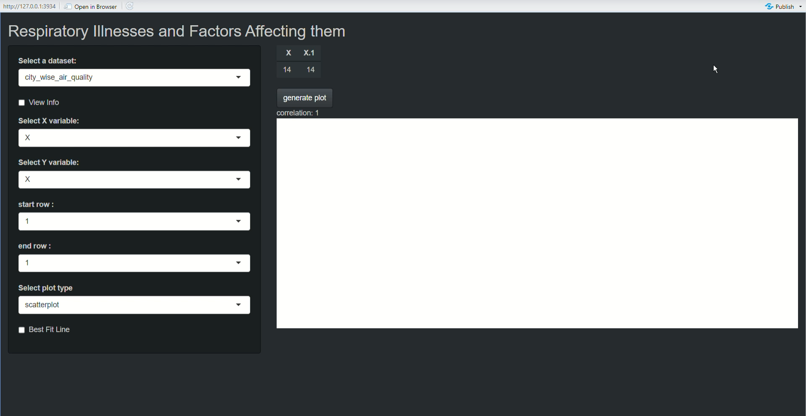
Video Demonstration

Slide 11

Conclusions
1
Identified Associations
Between air pollution, household factors, and respiratory illnesses in India.
2
Targeted Interventions
By improving clean cooking fuel usage and reducing tobacco consumption, we can potentially mitigate the impact of respiratory illnesses and enhance public health outcomes in India.
3
Further Research
However, it is essential to acknowledge the limitations of our analysis, such as the reliance on correlational data, and to conduct further research to establish causality.

Slide 12

Q&A
Thank you for your attention!

